Slide 1
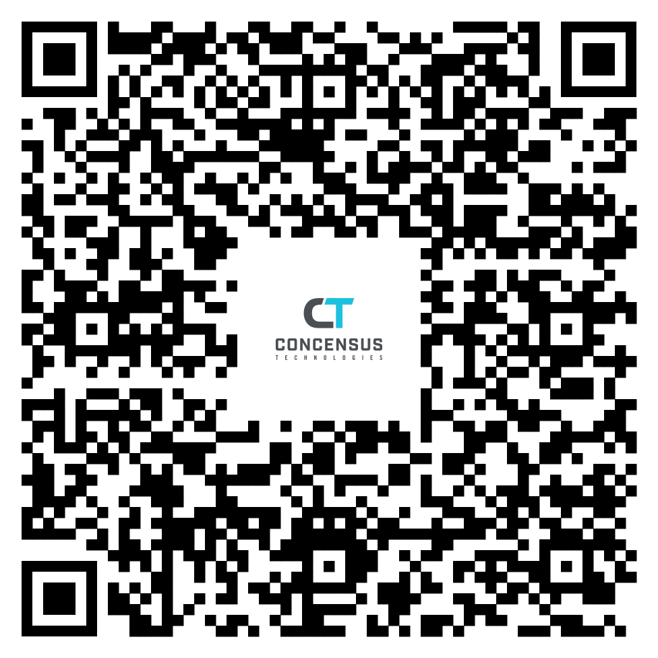

Slide 2
Building a cybersecurity plan for your school
Don DaRe
July 2022

Slide 3
Agenda
Cybersecurity – The What, The Why
Current Environment - Key Questions
Principles of Risk Management
Compliance
Policies
Incident Response Planning
Create Accountability

Slide 4
WHAT WE DO
IDENTITY & ACCESS
MANAGEMENT
CYBERSECURITY
CLOUD SERVICES
SALES, SERVICES, AND SUPPORT

Slide 5
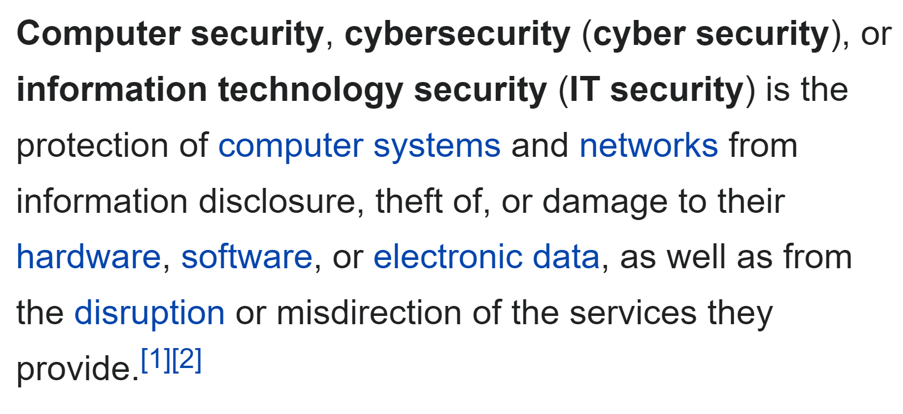
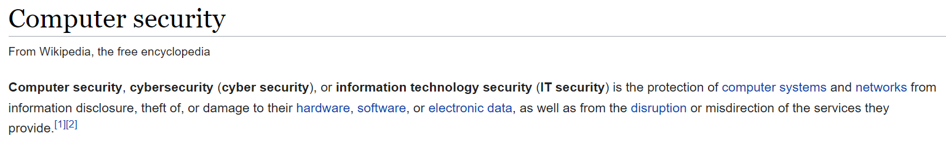
WHAT IS IT to YOU?

Slide 6
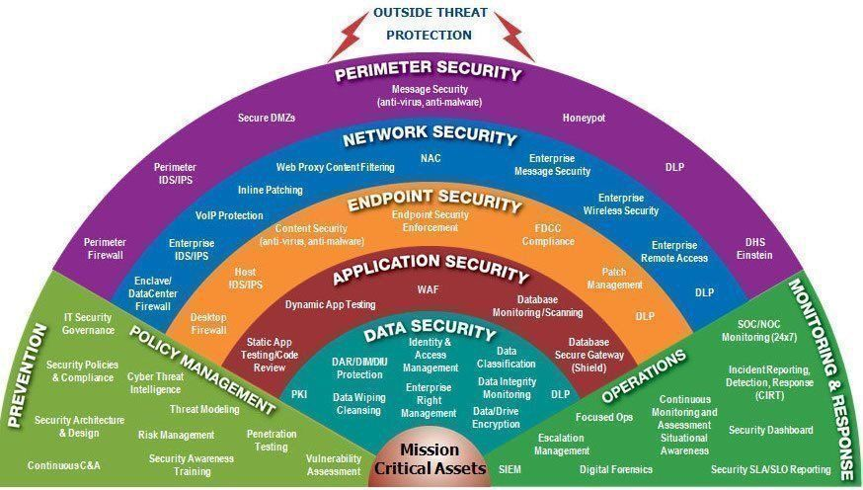
WHAT IT IS TO ME – DEFENSE IN DEPTH
57 Disciplines
7 Layers
Mission Critical Assets

Slide 7
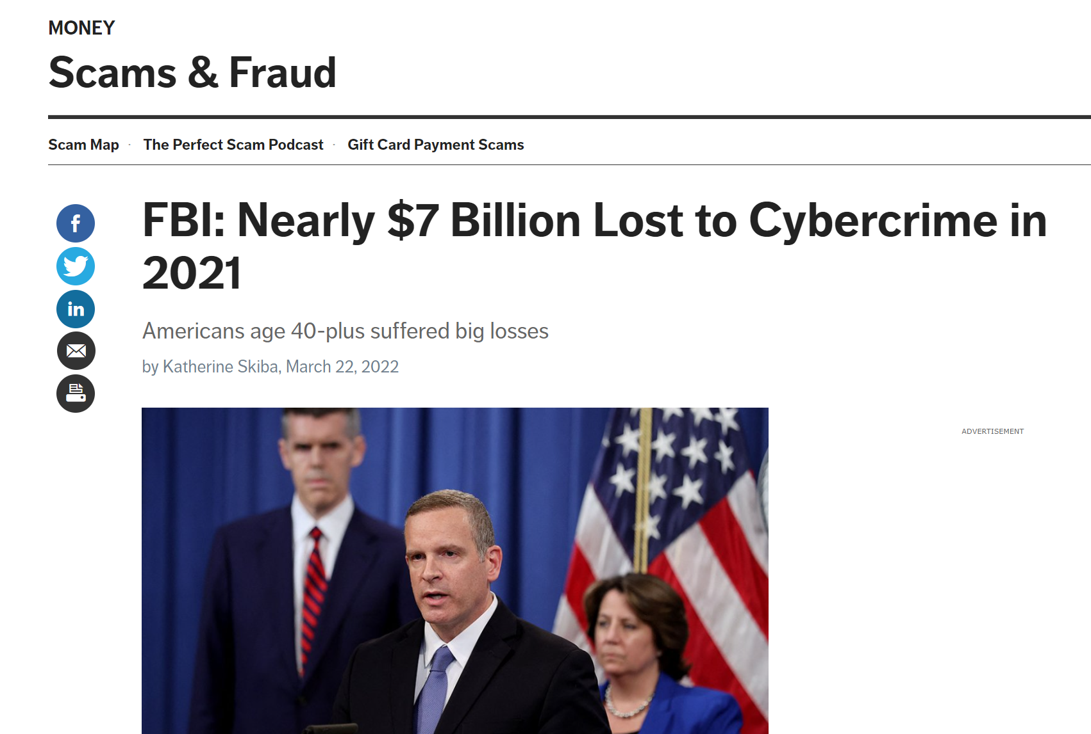
WHAT IT IS TO ORGANIZED CRIME $$$
$11m
$240k

Slide 8
NIST Cybersecurity Framework - TIME TO PLAN
IDENTIFY
Risk Assessment/Compliance/Assets
PROTECT
Tools, Training, Controls
DETECT
Continuous Monitoring
RESPOND
Response Plan
RECOVER
Recovery Plan

Slide 9
SAMPLE ROADMAP
2022
OCTOBER
NOVEMBER
DECEMBER
ASSESS (GAP)
Risk
Policies/Compliance
Environment Review
Prioritize Opportunities
Create Roadmap
SECURITY -Phase II
Tools Implementation
Monitoring Implementation
DR Implementation
SECURITY -Phase I
Policies
Plans
Details
Training
Monitoring/Patching/Vulnerability Management/Governance

Slide 10
ASSESSMENT – IDENTIFY CURRENT ENVIRONMENT
Do you use 2-Factor or Multi-Factor Authentication for E-Mail and Remote access?
Are you Encrypting Data at Rest?
Do you have an inventory of all your devices? Do you force updates?
Do you have offsite backups of your critical assets?
Do you have an Incident Response Plan?
Do you train your employees on security awareness, Wire Transfer fraud, social engineering?
Do you have a documented control for wire transfers?
What is your Most Critical Asset You want to protect?

Slide 11
RISK MANAGEMENT Principles
1. Identify
2. Analyze
3. Rank/Evaluate
4. Remediate
5. Monitor
Risk Management:
  Is the identification, analysis and treatment of potential impacts (based on the likelihood and consequence to the organization).
The Concensus Way:
  Identify
  Discuss
  Solve

Slide 12
RISK MANAGEMENT – It is about the Assets
Critical Data Assets
  Student/Staff Records
  Accounting: Financial Data
  LMS?
  CRM?
  Email?
  Gradebook?
Questions for Each
  RTO – What is my maximum tolerable downtime?
  RPO – What is my Recovery Point Objective? (How much data can I afford to lose)
  Does Compliance Apply? PHI/PII

Slide 13
Compliance
EXISTING REQUIREMENTS
FERPA
FSA – Federal Student Aid
Graham-Leach-Biley Act
  FTC Safeguard Rules
New FTC Safeguards Rules:
Single Qualified Individual Responsible for Information Security Program (GLBA) (CSO)
Written Risk Assessment*
Written Incident Response Plan*
Security Training
Minimize Retention of data
Penetration Testing/Monitoring*

Slide 14
Some Steps to Take for New Compliance
Designate an Internal Resource as Chief Security Officer
Implement Employee Wide Training ASAP
  Test Regularly and Collect Results
Encrypt Your data at rest
  Bitlocker/Mac Encryption
Document Change Management Plan
MULTI-FACTOR AUTHENTICATION
Create an Information Security Program Baseline (figure out your controls)

Slide 15
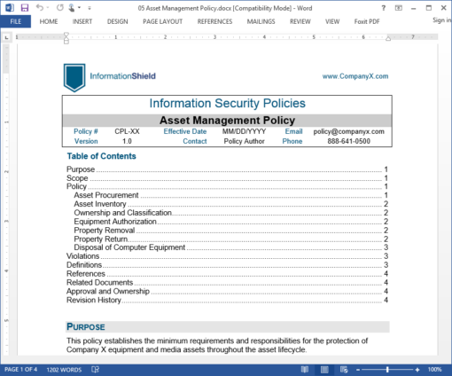
Policies
More than an acceptable use policy
  Needs Updates and Revisions (Track it!)
Policies Ensure Compliance
  Evidence Required
  Assignment/Ownership is Critical
Can help you with an Insurance Claim (hint, hint)
Doesn’t need to cost a lot!

Slide 16
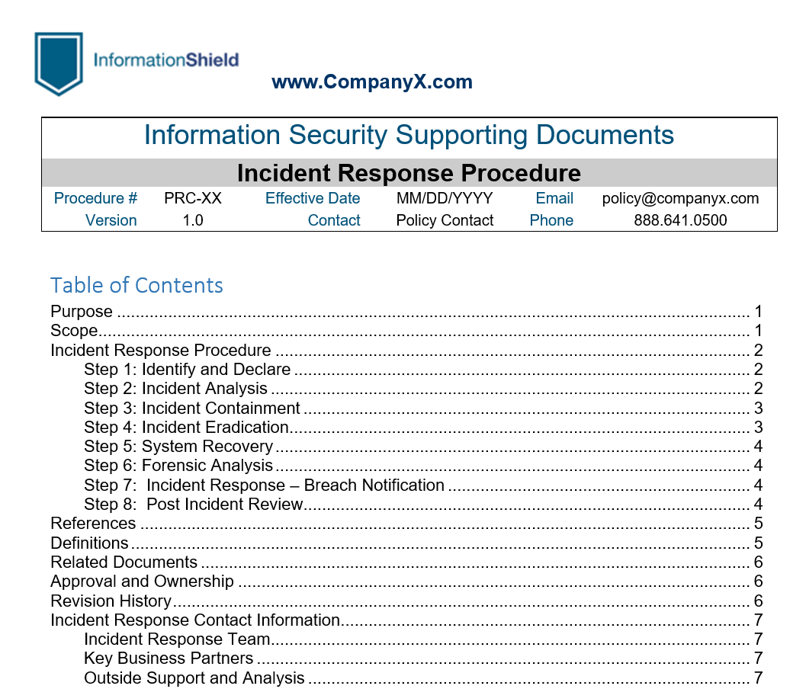
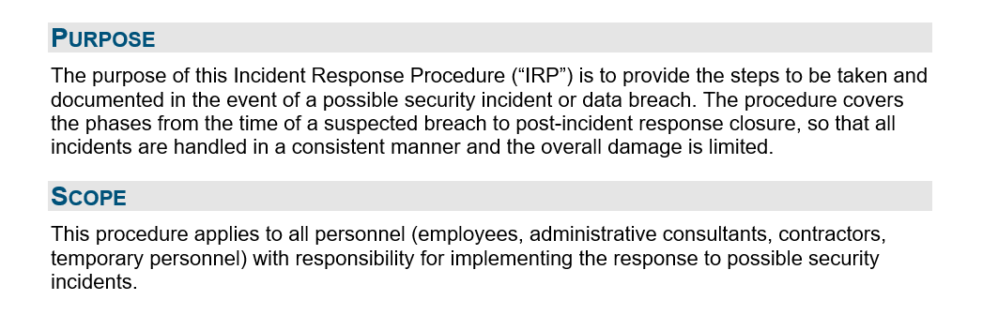
PREPARE A RESPONSE PLAN
1. Prepare a Plan & Policy
2. Assign Team Members
3. Include Severity

Slide 17
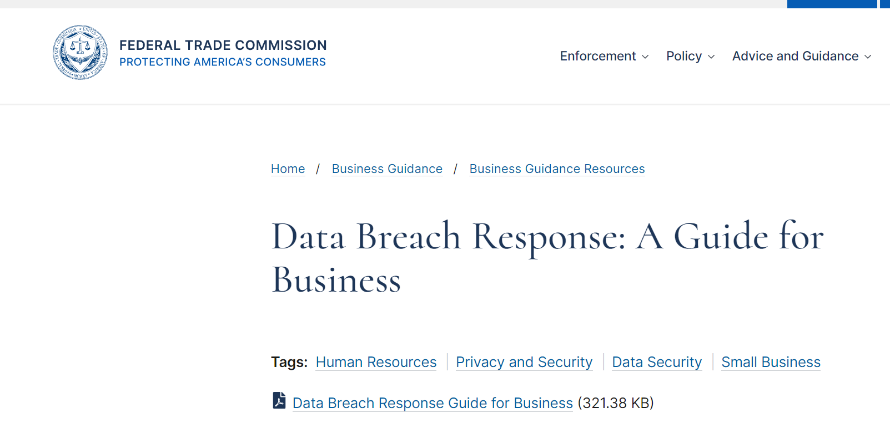
INCIDENT RESPONSE PLAN
1. Secure Your Operations
2. Fix the Vulnerabilities
3. Notify Appropriate Parties

Slide 18
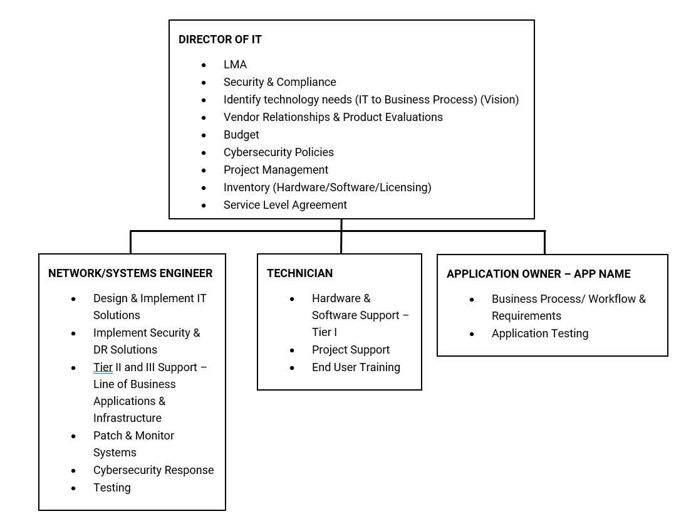
CREATE AN ACCOUNTABILITY CHART FOR IT

Slide 19
A SAMPLE SECURITY STACK
Microsoft 365 A3 or A5
  Azure AD Plan 1
  Data Loss Prevention
  Litigation Hold
  Message Encryption
  Defender
  Advanced Threat Analytics
RocketCyber SOC Agent (Continuous Monitoring)
ProofPoint – SPAM/Email archiving
Webroot – Security Awareness Training
Webroot Endpoint Detection and Response (AV)
Cisco Umbrella – Content Filtering
Cisco DUO – Multi-Factor Authentication
Veeam for Backup and Disaster Recovery (Systems/M365)
Compliance Shield – Polices/Controls/Program Management

Slide 20
Links
Incident Response Plan
Recovery Point Objective / Recovery Time Objective
FTC Strengthens Data Security Requirements for 2022
Compliance Shield Demo

Slide 21

THANK YOU
QUESTIONS
Sales@concensus.com
www.concensus.com/events

